Slide 1


2026
HR
Workforce
ReviewDate
Dim
RatingLevel
DIM
Intelligence
HireDate
Dim
Performance
Rating
Dashboard
SatisfiedLevel
DIM
A Power BI analytics solution exploring workforce
attrition, compensation, performance & diversity.
Employee
Attrition
Rate
WorkLife
Balance
TheMeasures
Education
Level
HR Data Analysis · Team of 6 · Power BI · 2025
01

Slide 2




THE TEAM
PROJECT OVERVIEW
Group
Members
HR Data Analysis
Exploratory and statistical analysis on IHR data to help organizations
make informed, data-driven decisions about their workforce.
1
Wael Mohammed Abbas
Team Leader
PROJECT GOALS
2
Ahmed Mamdouh Fawzi
Identify patterns & root causes of employee attrition
Analyze performance & compensation across departments
Satisfaction & File Merge
3
Antonious Hani Aziz
Performance & Ratings
Visualize workforce diversity & inclusion metrics
Build a foundation for predictive HR modeling
4
Ashraf Nabil Mohamed
Compensation + PPT
TOOLS & WORKFLOW
5
Gerges Alfy Naseif
Power BI
Python
GitHub
DAX / TMDL
Attrition Analysis
Omar Khaled
github.com/WaelMAbbas/Hr-Data-Analysis
6
Demographics
02

Slide 3







PROJECT FOUNDATION
Requirements Gathering
What we needed to understand before building the dashboard
STAKEHOLDER NEEDS
DATA REQUIREMENTS
DELIVERABLES
01
Understand why employees leave
Employee records
6-page Power BI dashboard
1,470 rows, full history
02
Identify high-attrition departments & roles
35 attributes
Star-schema semantic model in TMDL
Demographics, job, pay, perf
03
Monitor overall workforce health
Performance ratings
interactive visualizations
Self, manager, overall
04
Compare compensation across roles
Satisfaction scores
Word document narrative report
Job, env, relationship, WLB
05
Track performance & satisfaction trends
Date dimensions
PowerPoint presentation
Hire date & review date
06
Support DEI reporting with diversity data
Dimension tables
GitHub repository with full history
7 DIM tables for star schema
01

Slide 4





ANALYTICAL FRAMEWORK
Questions to Be Answered
The core HR business questions driving every dashboard page
ATTRITION
COMPENSATION
Who is leaving, and why?
Is pay fair and competitive?
› Which departments have the highest attrition rate?
› What is the salary range across roles and departments?
› Does overtime, distance, or marital status drive exits?
› Is high-attrition Affected by lowest-paid?
› At what tenure point are employees most likely to leave?
› Is tenure rewarded with higher compensation?
PERFORMANCE
SATISFACTION & WELLBEING
How do employees perform and get rated?
What drives employee satisfaction?
› What is the distribution of overall vs manager vs self ratings?
› Do dissatisfied employees leave at a higher rate?
› Are high performers leaving at higher-than-expected rates?
› Which department has the worst work-life balance?
› Is there a gap between manager and self-assessment?
› How do relationship & env. satisfaction link to attrition?
DEMOGRAPHICS
TRAINING & DEVELOPMENT
Who makes up the workforce?
Is learning investment paying off?
› What is the gender and ethnicity distribution by department?
› What proportion of employees fully utilise training?
› Which age group has the highest attrition risk?
› Which departments are over- or under-utilized in training?
› How does marital status affect retention?
› Does training utilization correlate with retention?
02

Slide 5



END-TO-END PROCESS
Analysis Workflow
From raw CSV to interactive Power BI dashboard — our complete pipeline
01
02
03
04
05
Raw Data
›
Data
Cleaning
›
Data
Modeling
›
Dashboard
Design
›
Insights &
Reporting
Input
Power Query
TMDL / DAX
Power BI
Deliverables
· HR CSV dataset
· Handle nulls
· Star schema design
· 11 report pages
· Key findings
· 1,470 employees
· Standardize types
· 7 dimension tables
· 60+ visuals
· Word report
· 35 columns
· Age groups, buckets
· DAX measures
· KPI cards & slicers
· PowerPoint deck
KEY TOOLS
CSV / Excel
Power Query
DAX
TMDL
Power BI
GitHub
Python
Source data
ETL & transformation
Measures & KPIs
Semantic model
Visualization
Version control
EDA & scripting
04

Slide 6
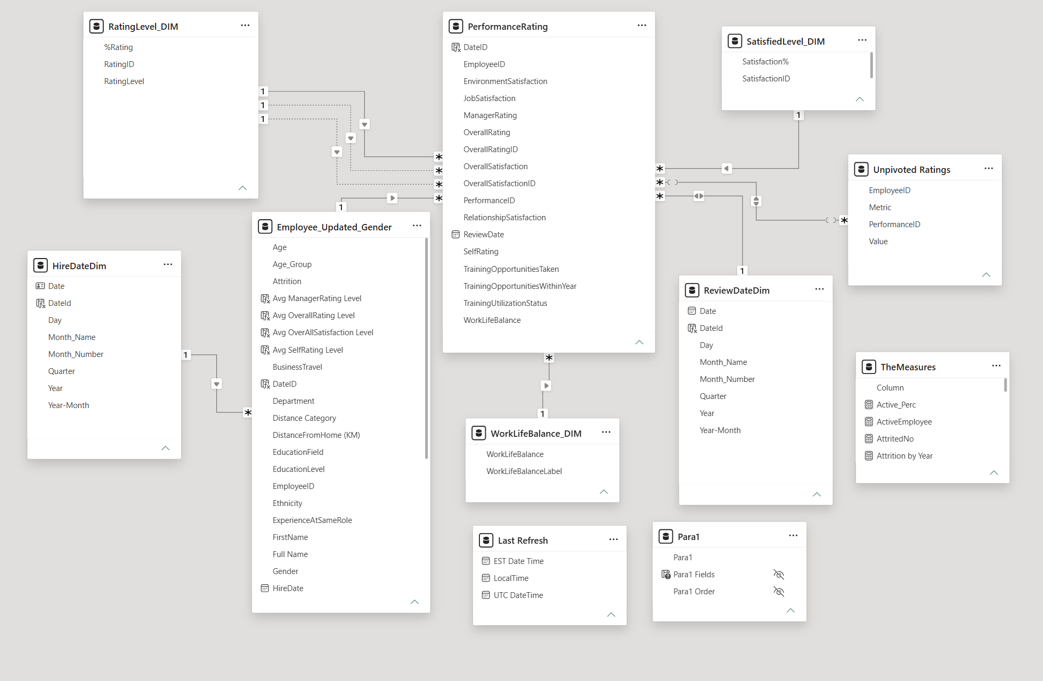
POWER BI SEMANTIC MODEL
Data Model — Star Schema
Fact table connected to 7 dimension tables via TMDL semantic model
TABLE LEGEND
FACT
Employee
Core fact table — 1,470 rows, 35 columns
FACT
PerformanceRating
Review-level ratings & satisfaction scores
DIM
RatingLevel_DIM
Maps rating IDs to descriptive labels
DIM
SatisfiedLevel_DIM
Satisfaction ID to % and label
DIM
WorkLifeBalance_DIM
WLB score to label mapping
DIM
HireDateDim
Date dimension for hire date analysis
DIM
ReviewDateDim
Date dimension for performance reviews
DIM
Unpivoted Ratings
Transforms data into a longitudinal tabular view to generate meaningful insights and outcomes.
CALC
TheMeasures
DAX measures: Active%, Attrition_Rate, etc
03

Slide 7
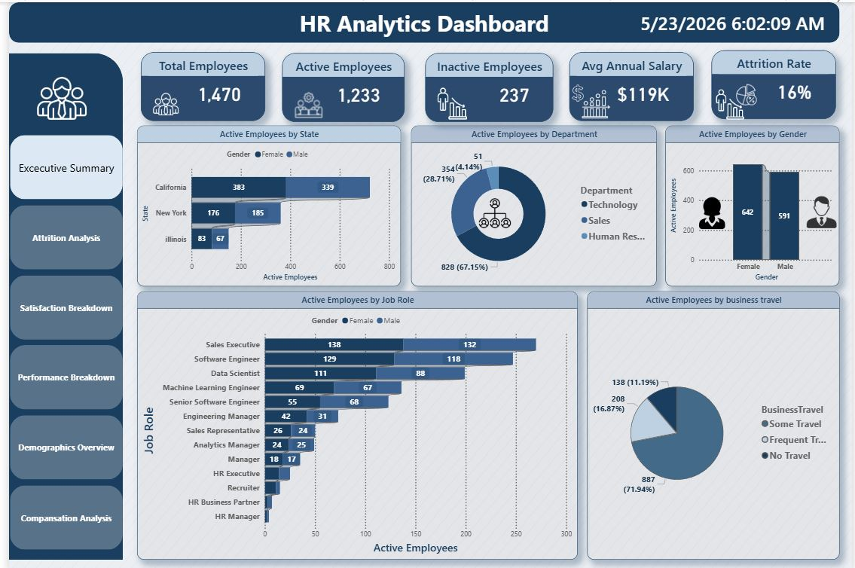
DASHBOARD WALKTHROUGH
Executive Summary Dashboard
5 KPI Cards
Total (1,470) · Active (1,233) · Inactive (237) · Salary ($119K) · Attrition (16%)
By State
California leads with 722 employees across 3 states
By Department
Technology 67% · Sales 29% · Human Resources 4%
By Gender
Male 591 · Female 642 active employees
By Job Role
Sales Executive & Software Engineer lead headcount
By Business Travel
71.94% No Travel · 16.87% Some Travel
05

Slide 8




PAGE 1 · WAEL
EXECUTIVE SUMMARY
Workforce Snapshot
1,470
1,233
237
16.1%
$6,500
Total
Employees
Active
Employees
Attrited
Employees
Attrition
Rate
Avg. Monthly
Salary
KEY INSIGHTS
1 in 6 employees exits each year — 237 of 1,470
Sales attrition (20.6%) is highest by department
Males = 60% of workforce but 63% of attrition
Salary ranges: $2.6K (Sales Rep) → $17K (Manager)
04

Slide 9
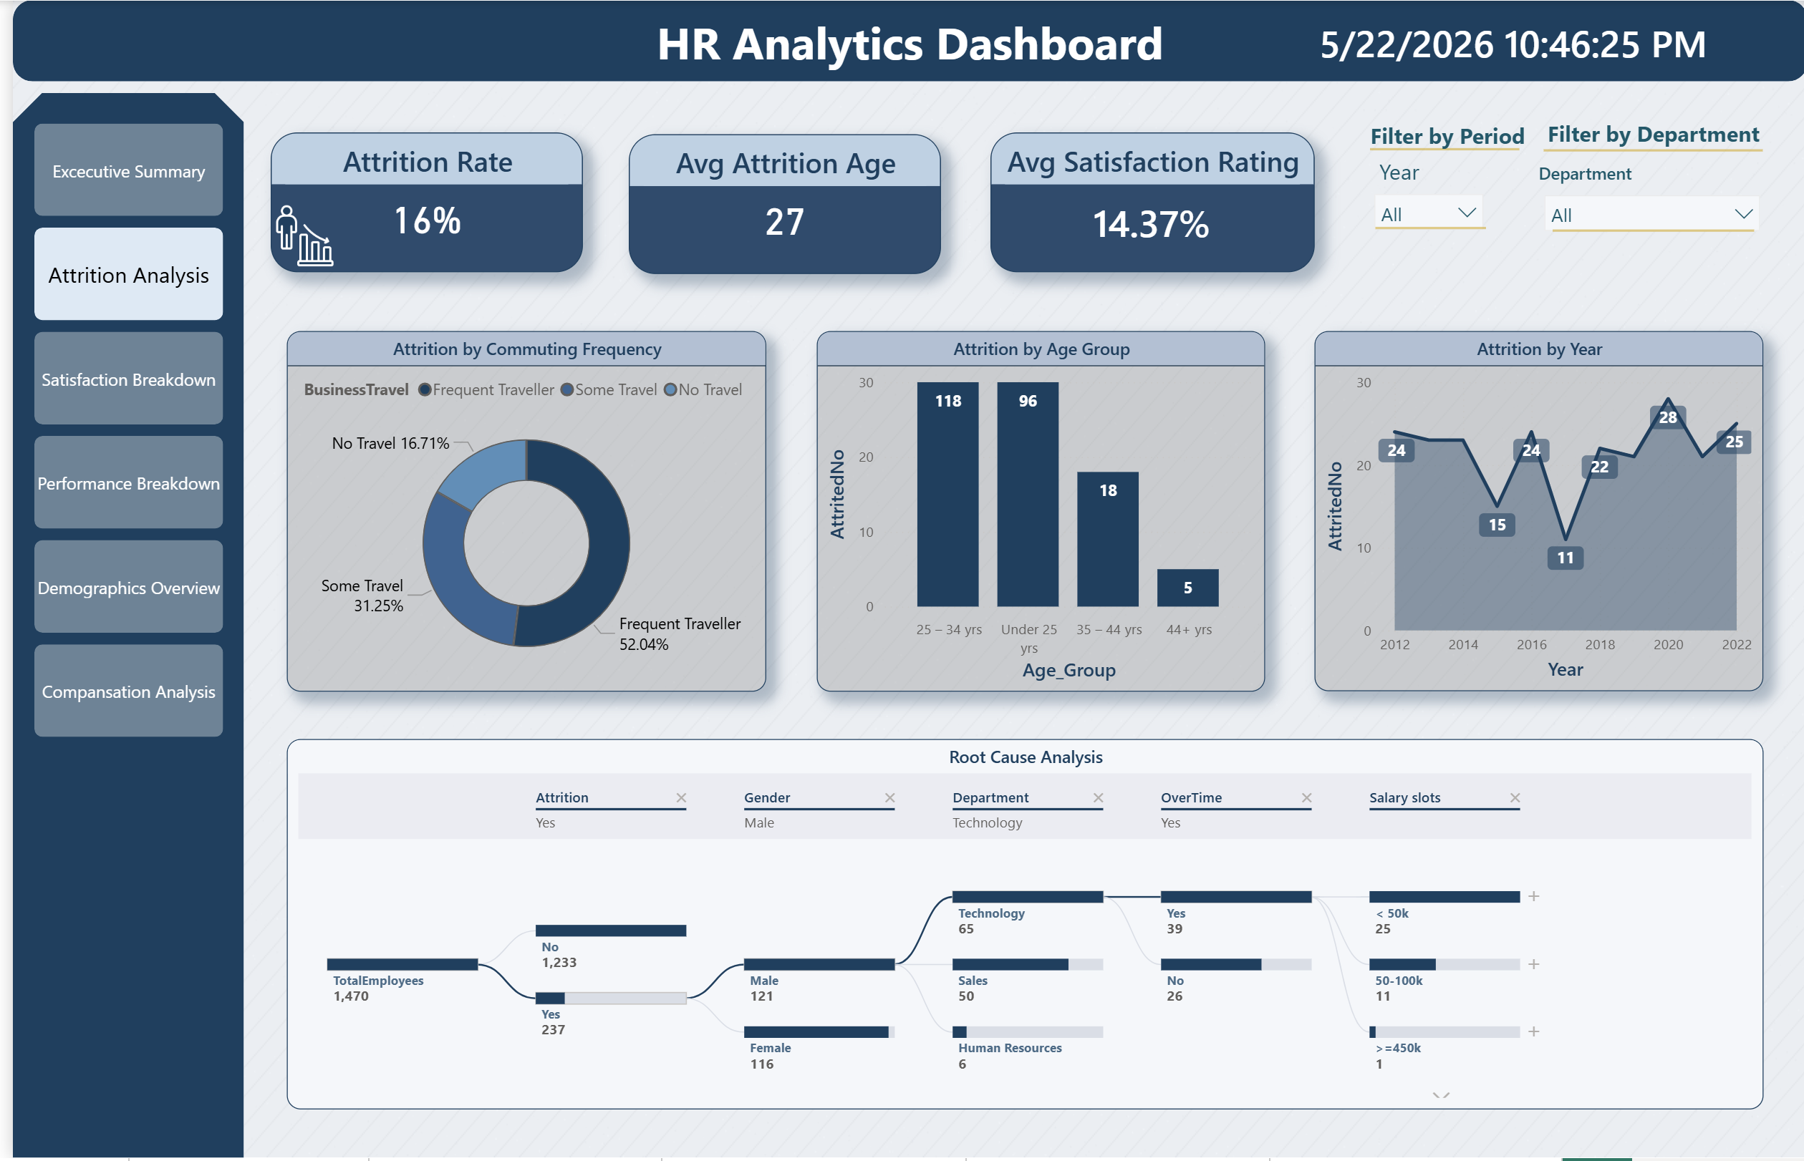
PAGE 2
ATTRITION ANALYSIS
Who Is Leaving — And Why
3 KPI Cards
Attrition Rate 16% - Avg Attrition Age 27 – Avg Satisfaction Rating 14 %
By commuting Frequency
Frequent travelling is leading by 52.04
By Age Group
24-34 is leading by 118 employees
By Year
Year 2020 is the highest attrition year
Root Cause Analysis
Most of attrition employees are male, IT department and they are having overtime frequently

Slide 10
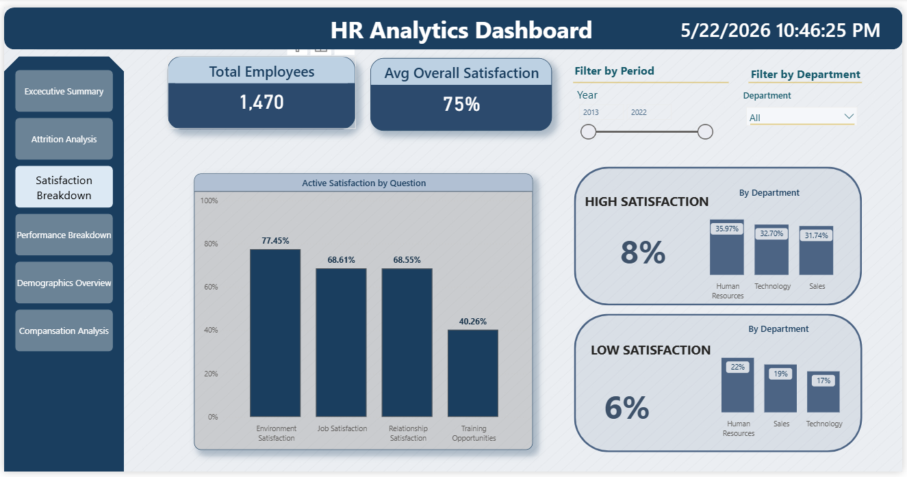
PAGE 3
SATISFACTION & WORK-LIFE BALANCE
Employee Wellbeing & Retention Risk
2 KPI Cards
Total 1470 – Avg overall satisfaction 75%
Active Satisfaction by Question
Environment Satisfaction is leading by 77.45%
High Satisfaction
Human Resources
Low Satisfaction
Information Technology

Slide 11
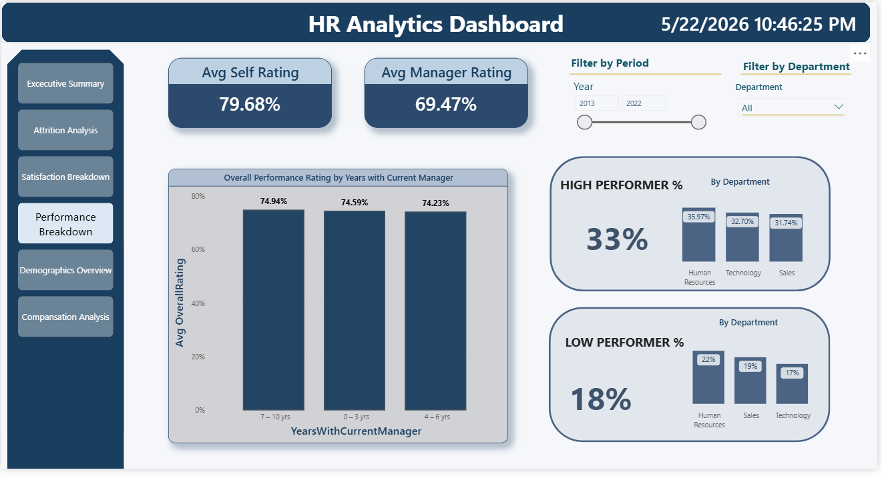
PAGE 4
PERFORMANCE & RATINGS
How Employees Perform & Where They're Rated
2 KPI Cards
Avg Self rating 79.68% - Avg Manager Rating 69.47%
Overall Performance Rating By Year
7-10 years is leading by 74.94
High Performer
Human Resources
Low Performer
Information Technology

Slide 12
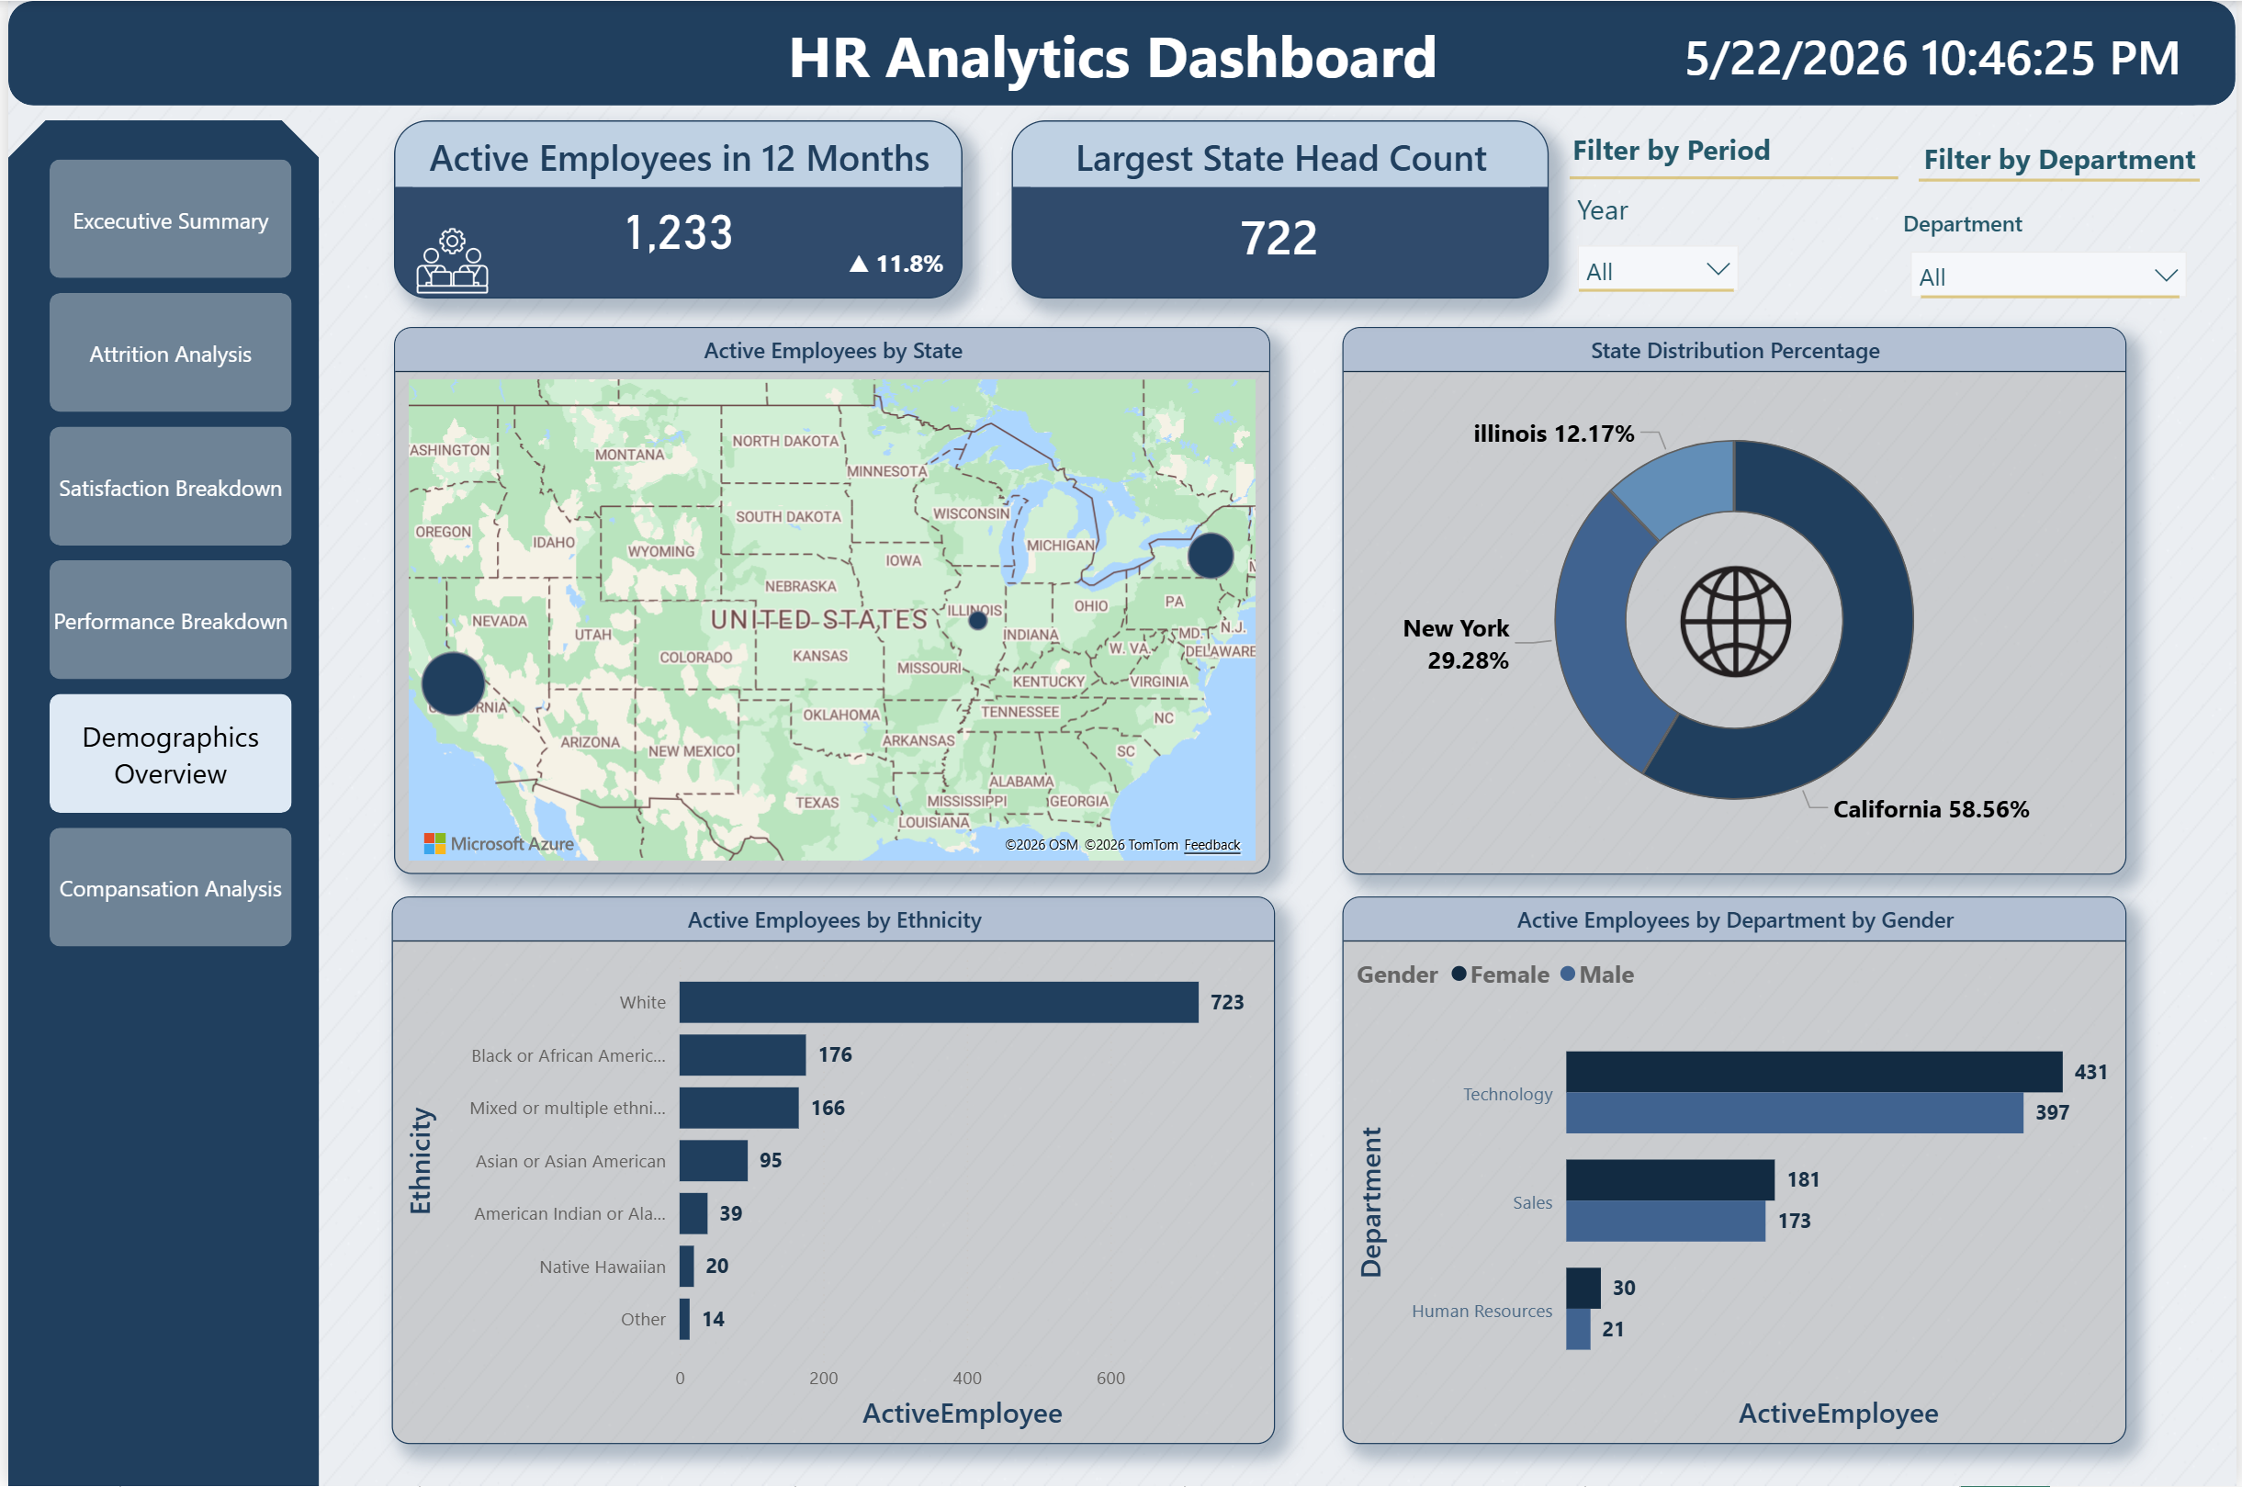
PAGE 5
Demographics
2 KPI Cards
Active Employee last 12 months (1,233) ·Showing an increase by 11.8% ·Largest numbers of payroll in a state is 722
By State
California leads with 722 employees across 3 states
By Gender
Data support that the company apply gender equality for each of its departments
By Ethnicity
White Ethnicity has been taken the lead, yet there is a clear diversification within the company
Filter
Sales Executive & Software Engineer lead headcount We have two filters for year and department
05
07

Slide 13
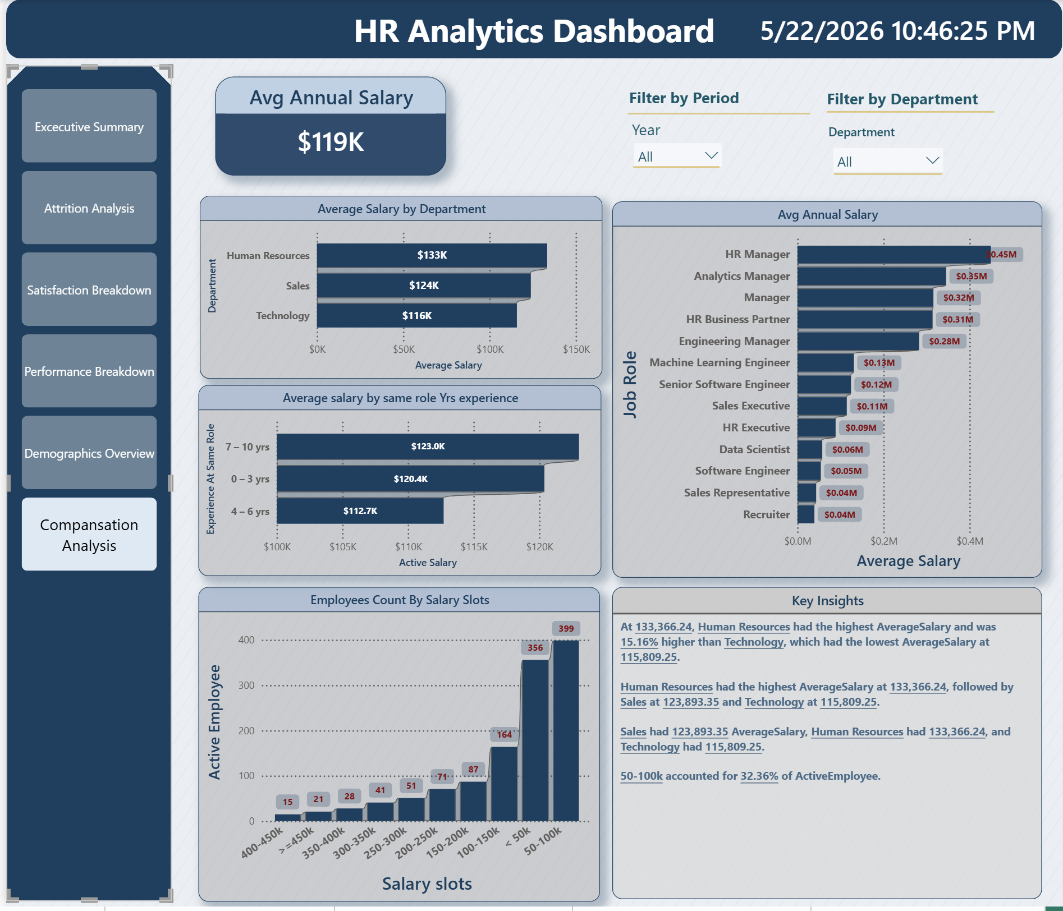
PAGE 6
Compensation Analysis
1 KPI Card
Average Annual Salary ($119K) ·
By Department
HR Department has the highest Average salary
By Title
Mangers have the highest paid salaries
By Count
50-100K accounted for 32.36% of employees
Filter
Sales Executive & Software Engineer lead headcount We have two filters for year and department
05
07

Slide 14
THANK YOU
HR Data Analysis Project
A data-driven approach to understanding and improving
workforce health, retention, and equity.
1,470
11
16.1%
27
Employees Analysed
Dashboard Pages
Attrition Rate Found
Average Attrition Age
Team: Wael · Ahmed · Antonios · Ashraf · Gerges · Omar
github.com/WaelMAbbas/Hr-Data-Analysis
11

